Slide 1

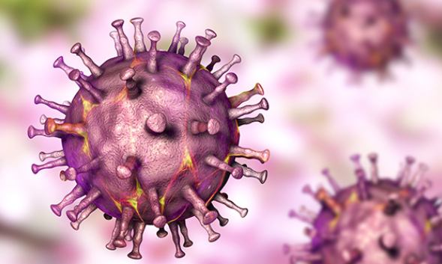
Emergency Disease Control
AFRICAN Swine Fever
Anthony Pearson – Global Head Technical and Marketing Bio-security and Hygiene
July 2019

Slide 2

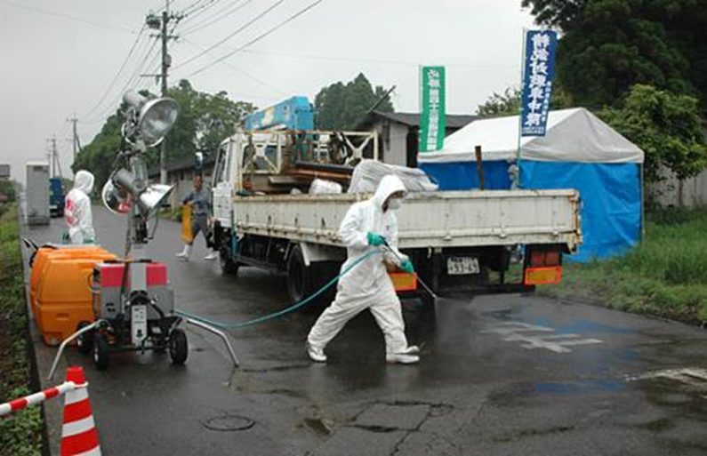
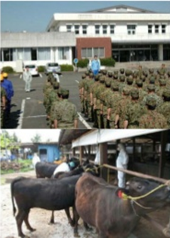
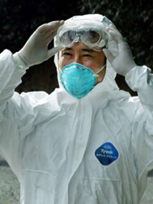
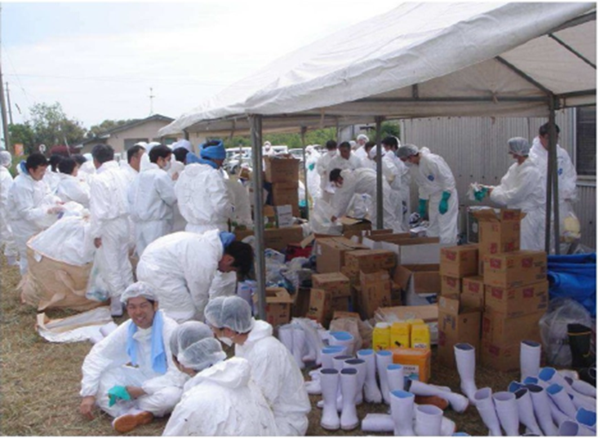
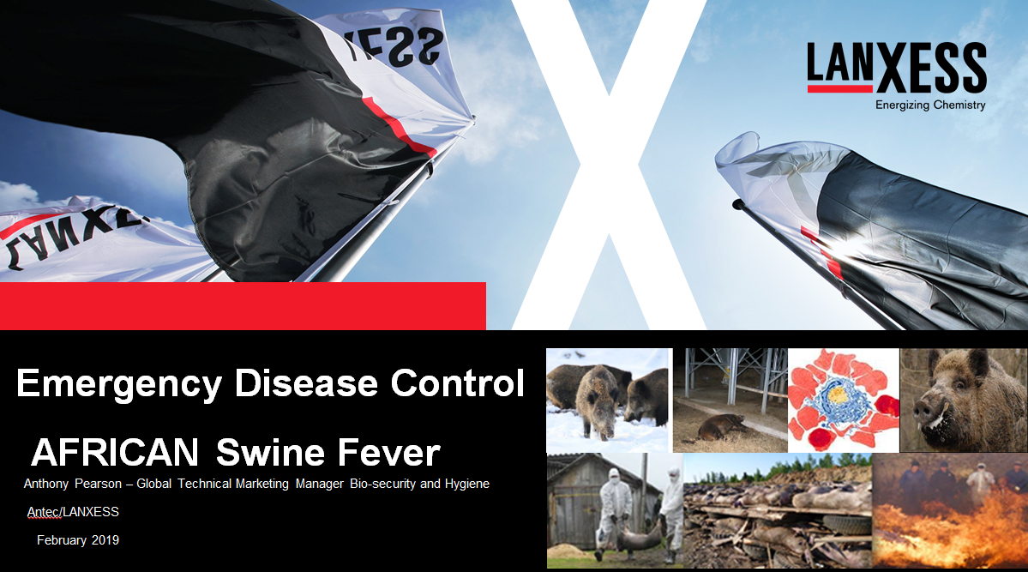
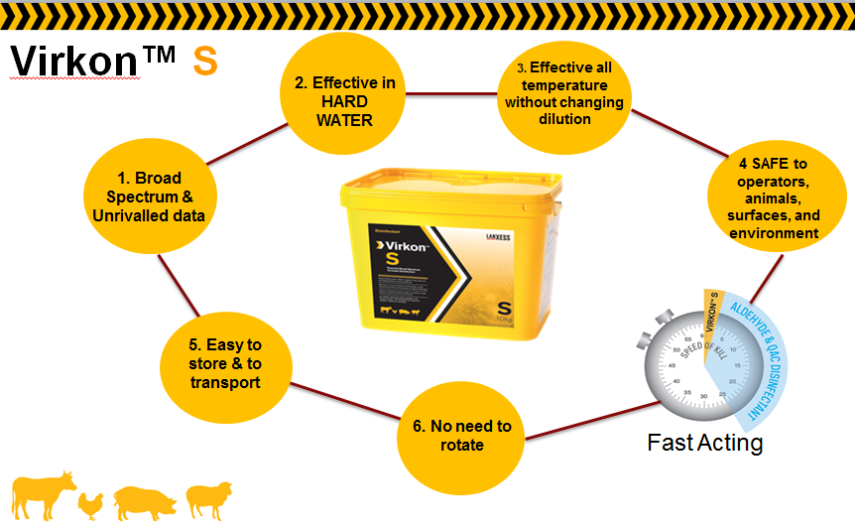
Emergency Disease response and support
E.D.C
Bio-security
Our team is supporting and assisting EDC challenged areas, globally working with Governing bodies, FAO and OIE (AH & HH)
Support is both non-commercial – for general training/awareness and ‘experience’ sharing’ ; Biosecurity guidelines (around chemistry)
Practical support
and Commercial – training with chosen product/s for safety in use/ application/ preparation /
Typically outbreaks involve unskilled operators –
Commercial Business
Advanced Biosecurity – Innovation and support to all livestock enterprises
Virkon™ S with proven data to assist reduce the challenge of ASFv

Slide 3
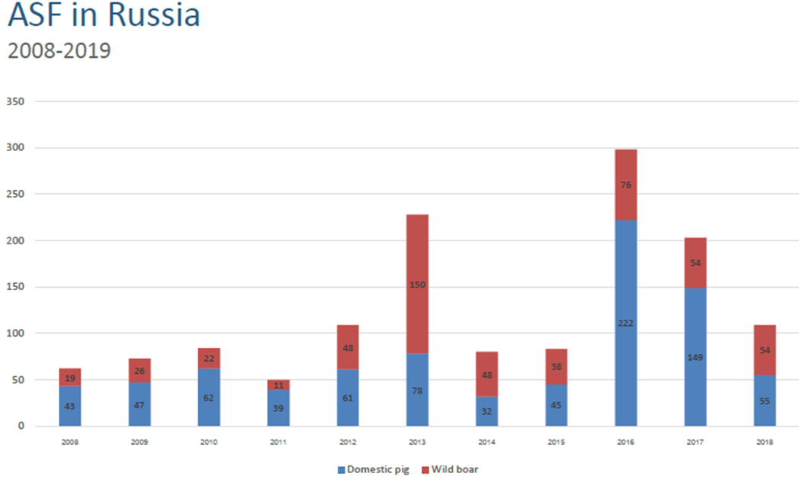
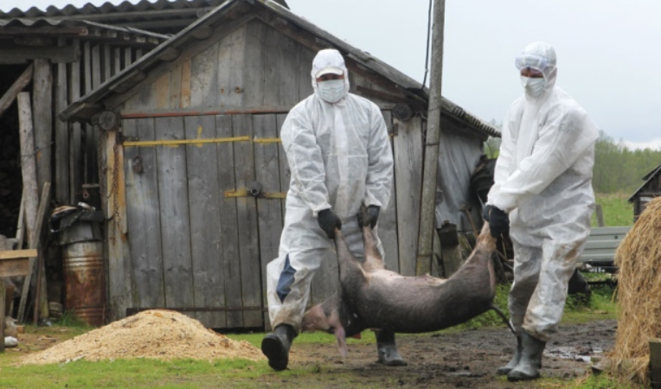
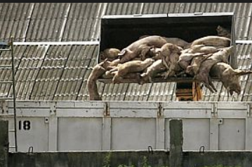
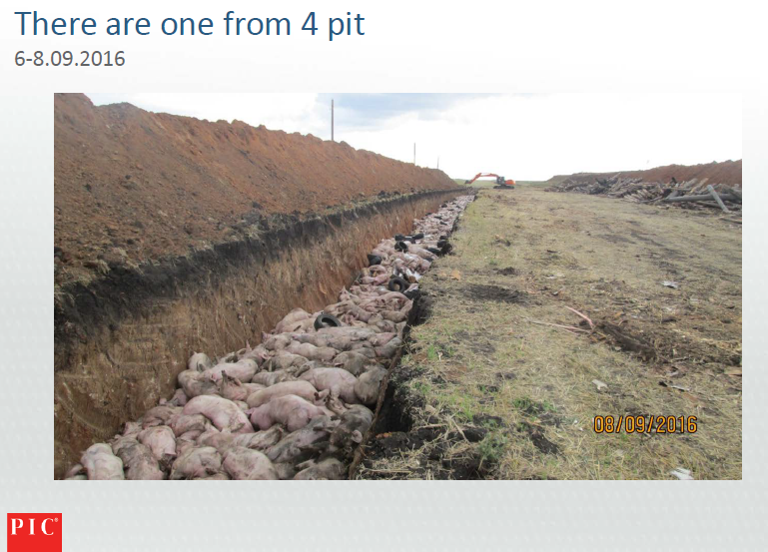
Russia was massively impacted by African Swine Fever
The challenges were managed by the regional governments but when Federal government took over, with compensation, protocols improved, but it is an ongoing challenge – 11 years, ‘living’ with ASFv
Courtesy of Dr. Konovalova PIC

Slide 4
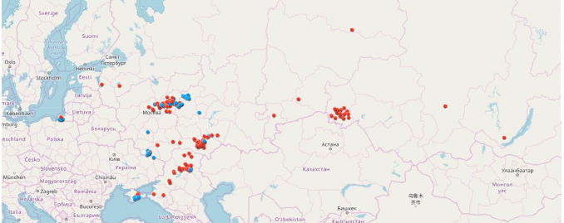
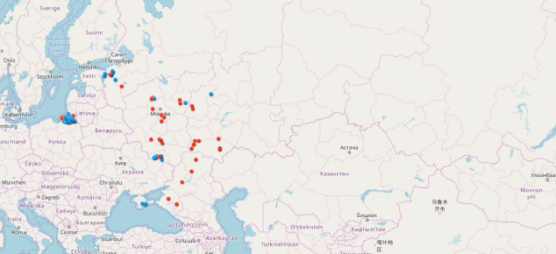
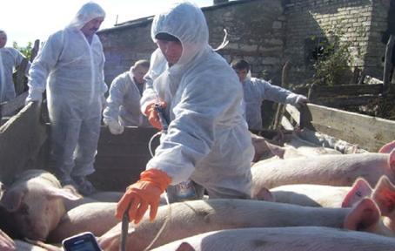
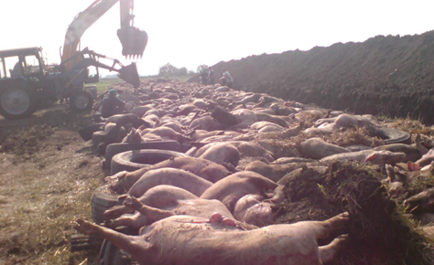
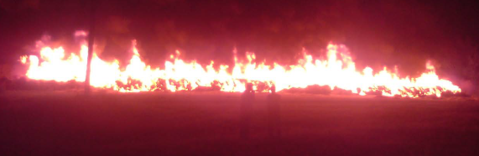
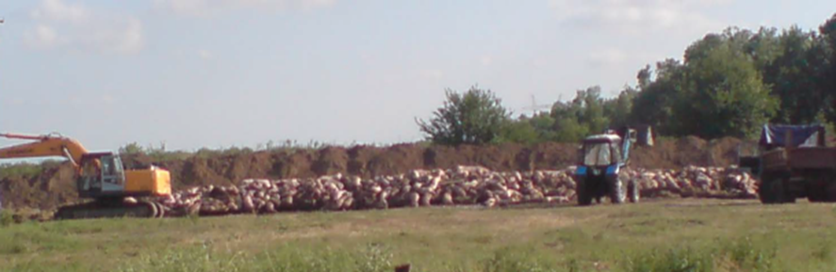
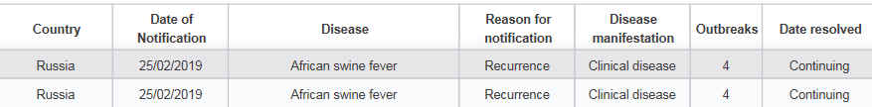
Russia was massively impacted by African Swine Fever
2017
2018
25th August 2018
There is a lesson to learn from the experience – controlled culling and management of movement with strong barriers

Slide 5
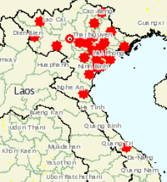


‘2019 : Living with a disease !’ – African Swine Fever – Europe and Asia
Dynamics of the Virus for which there is no vaccine option – so far…
The latest Dynamic is Vietnam – 3,000,000 pigs now affected
In July outbreaks in :
Lao, China, Hong Kong, Cambodia, Vietnam
Russia ,Latvia , Belgium, Hungary, Ukraine ,Poland, Romania, Bulgaria,
South Africa
All reported on the ‘weekly update’ from the O.I.E.

Slide 6
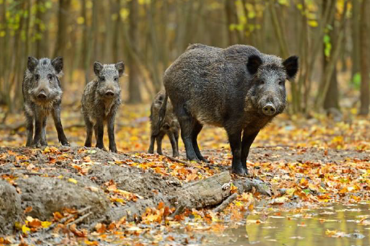
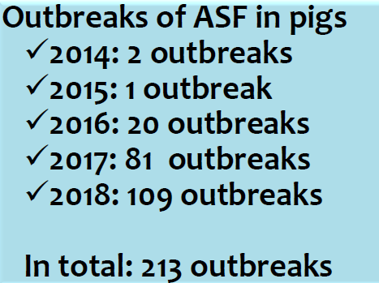
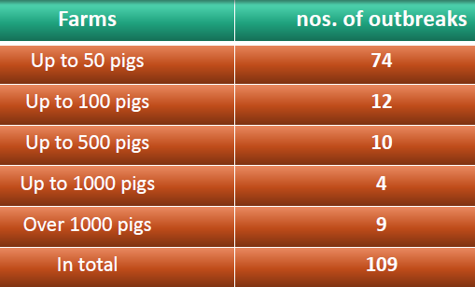
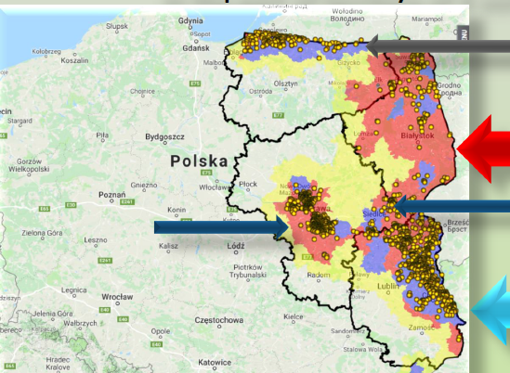
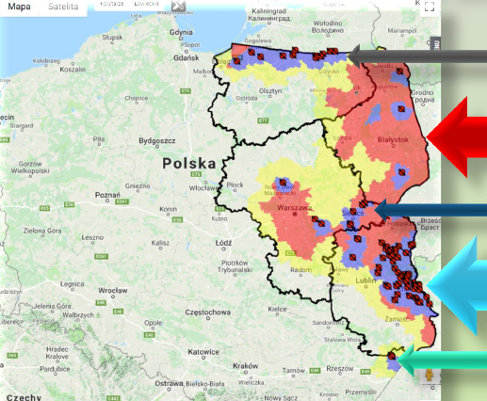
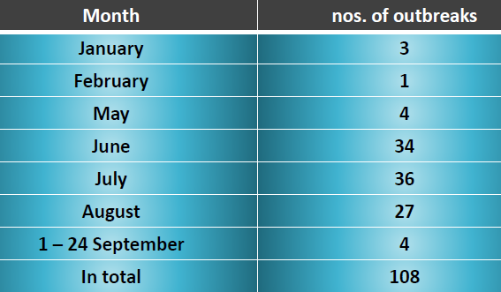
Poland, ‘living’ with ASFv’
Major success– BUT the virus is ‘walking’ Westwards and commerical outbreaks are increasing
Government participation with Industry
Invested in Barrier Controls – Wheel Dips/Arc Sprays/Fencing/Vector traffic control
2014 to December 2018
213 outbreaks in Pigs
3,347 outbreaks in Wild Boars

Slide 7
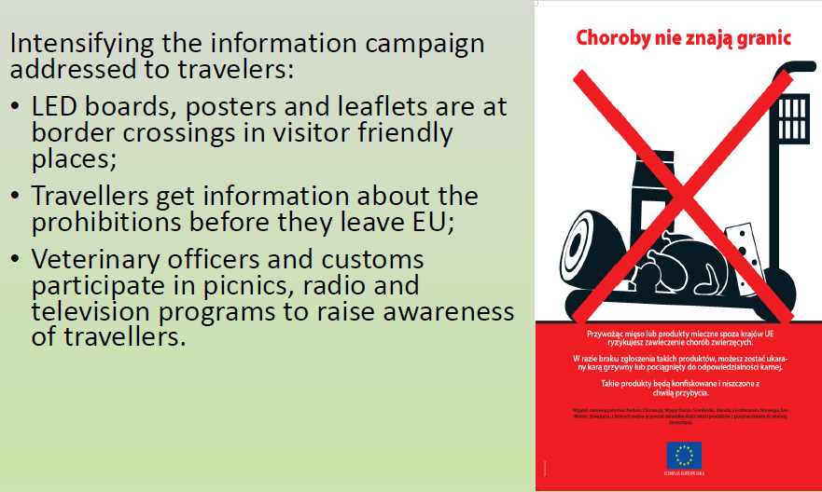
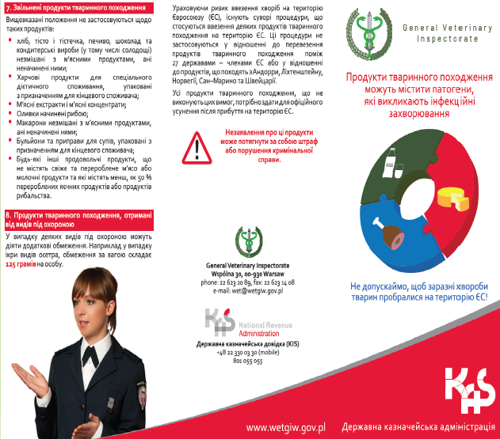
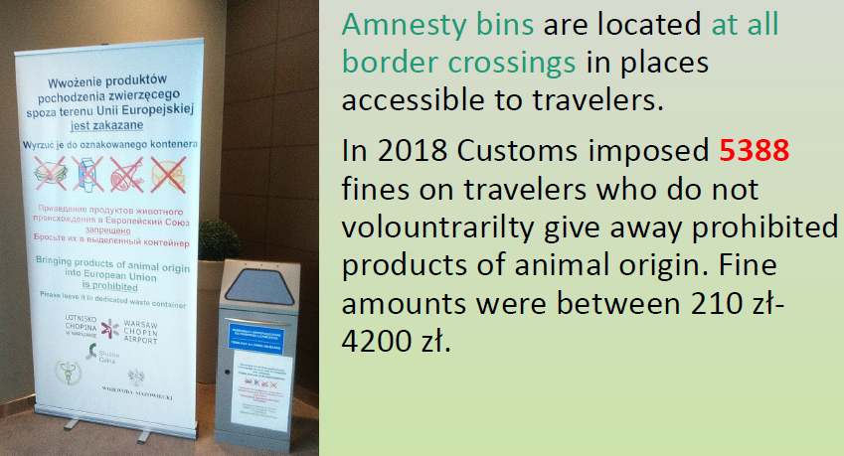
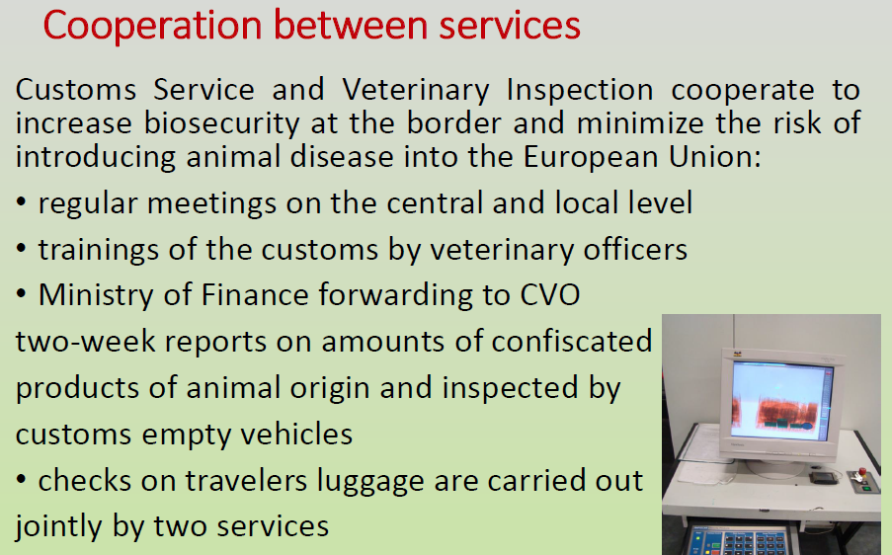
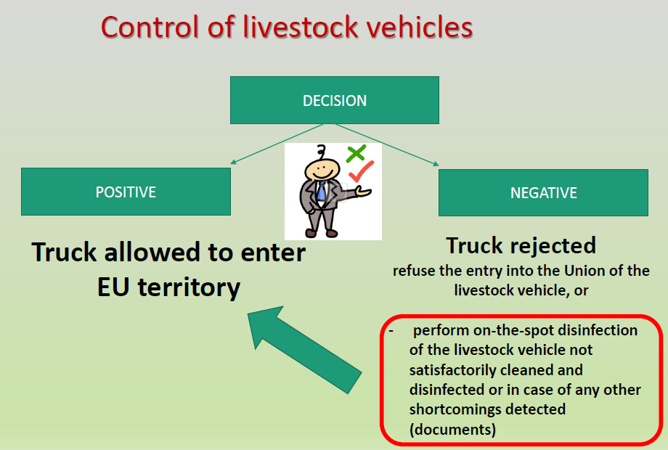
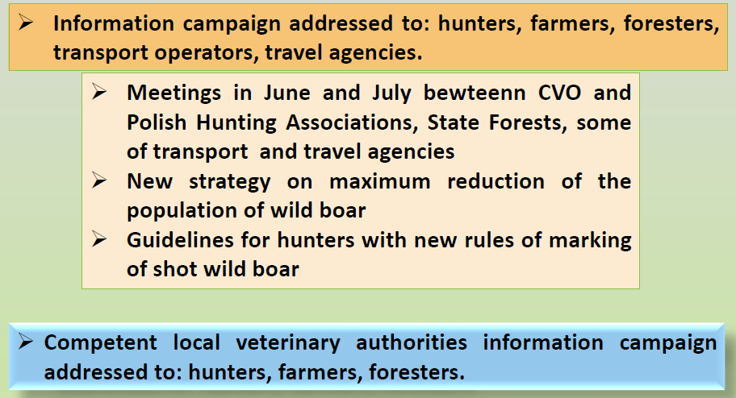
Action in Poland with Government/Industry co-operation
Government support to industry

Slide 8
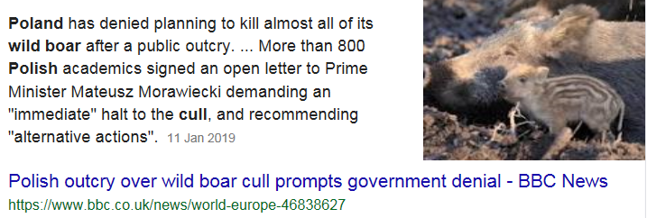
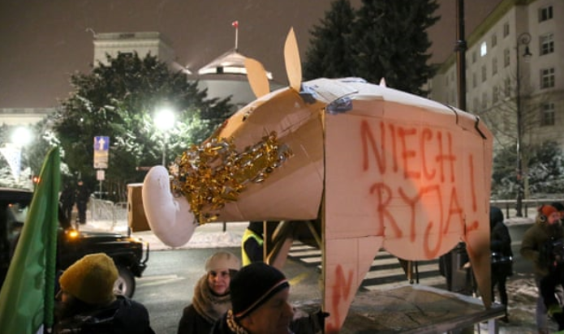
Action in Poland with Government/Industry co-operation
20,000 Wild Boars – CULL …….>>>>Public outcry !
A plan to cull 20,000 wild boars was halted by a Public Outcry….

Slide 9
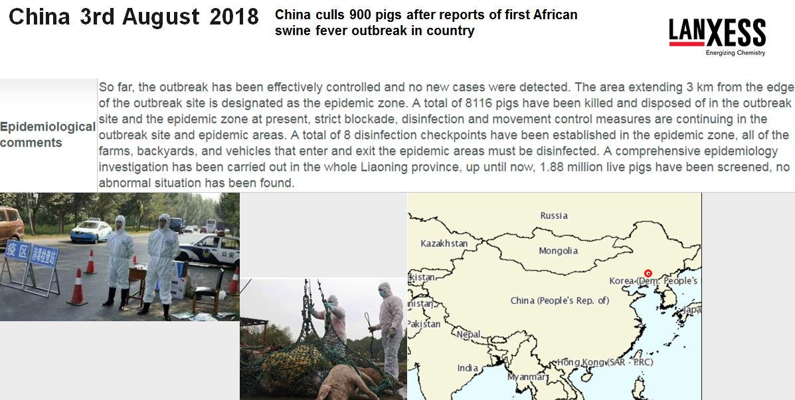
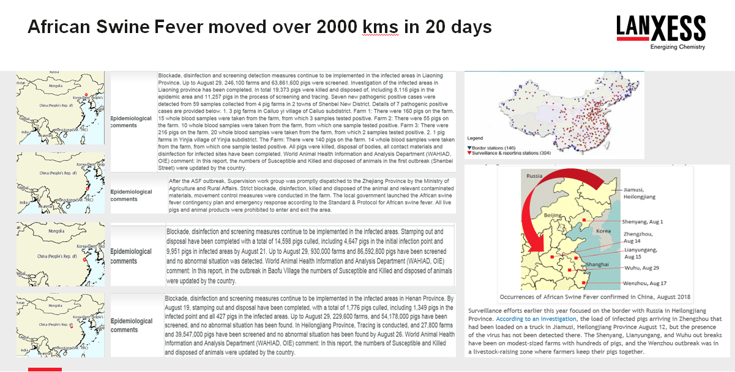
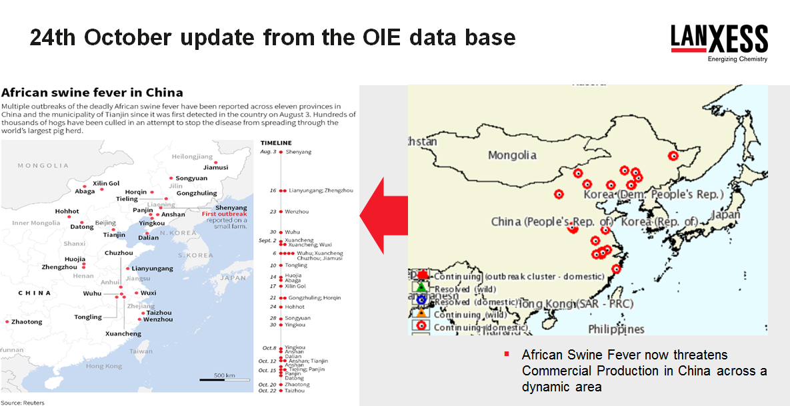
China was not able to control movement of infected pigs
The spread of the Virus was dynamic in China, despite Training and Awareness – pig movement controls were not observed

Slide 10
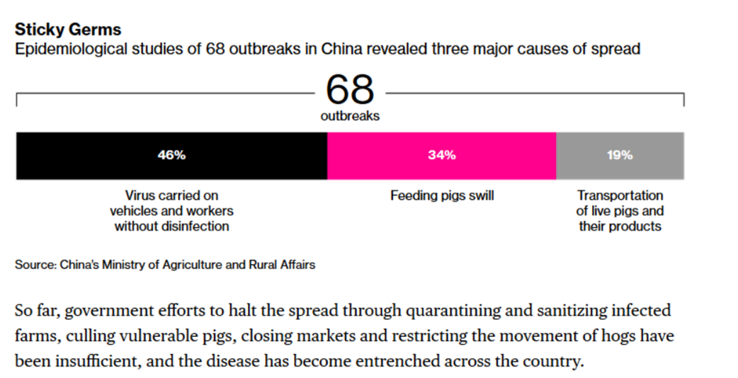
China was not able to control movement of infected pigs

Slide 11
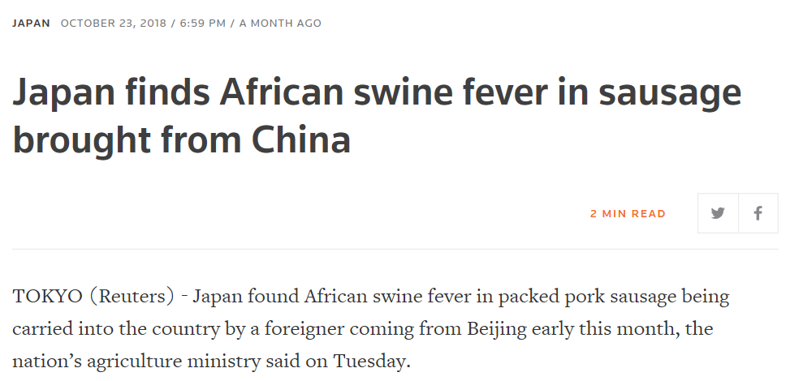
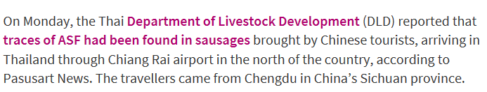
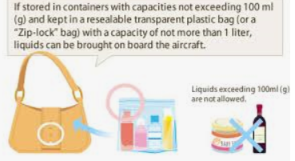
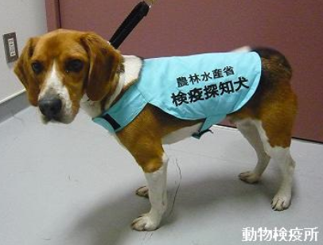
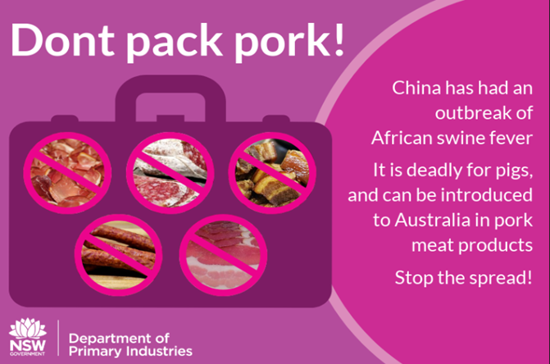
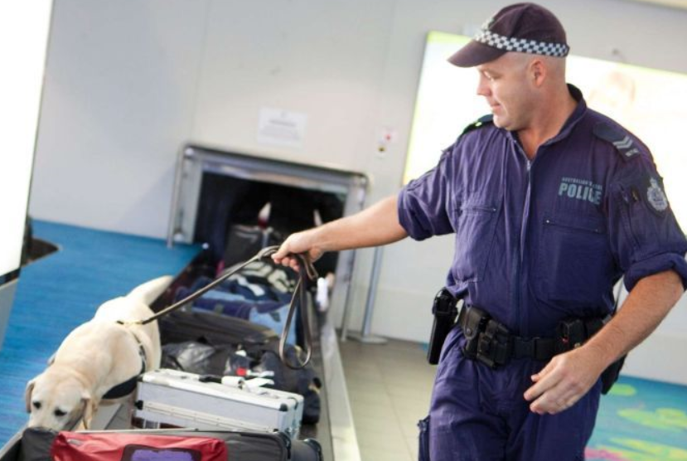
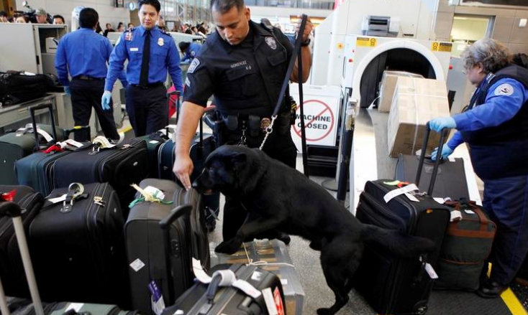
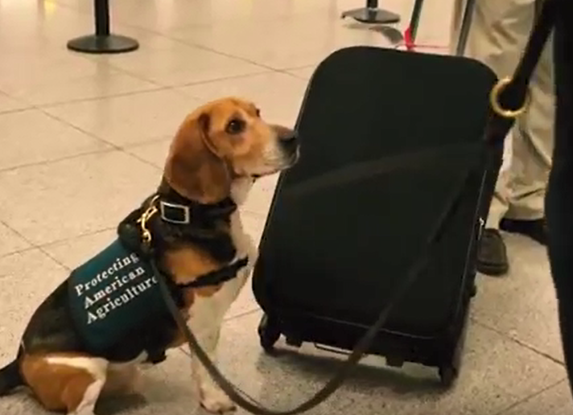
Global movement ?! – controls under pressure
ADDITIONAL Check carry on bags BEFORE flights ?
Canine customs support is in-obtrusive and works well - AUZ can give guidance

Slide 12
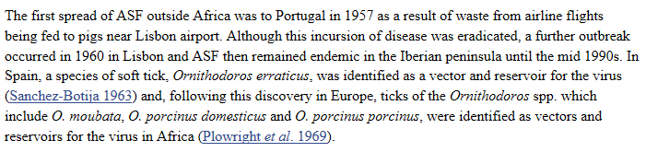

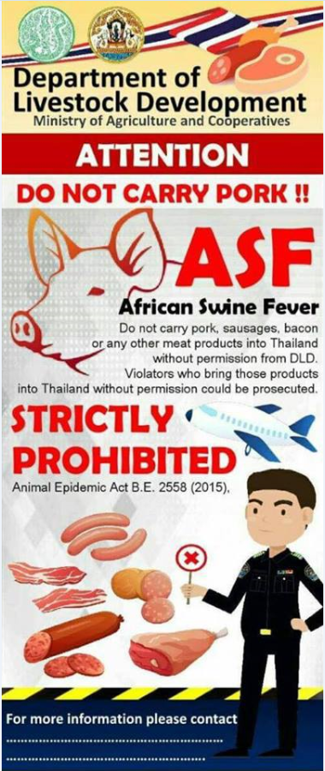
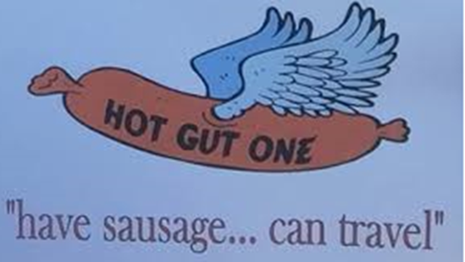
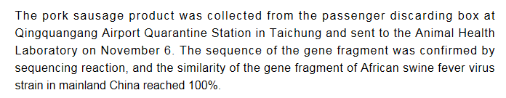
Is ASFv – coming on an airplane to you !?
2018 November Taiwan, Sth Korea, Japan 23rd October & Thailand 26th November
Leaflets alone will not stop the risk – actions at border crossing points are needed

Slide 13
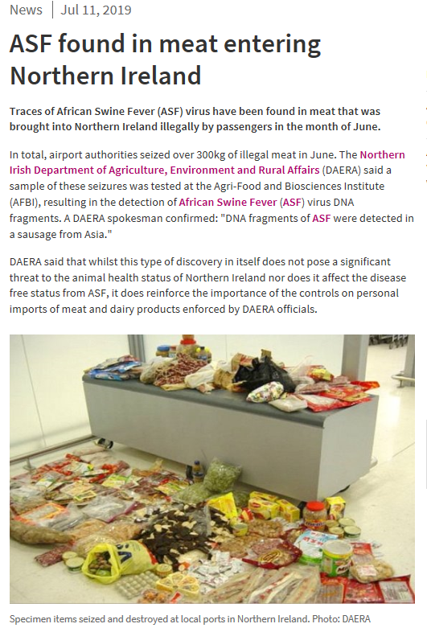


Global movement ?! – controls under pressure
Searching hand luggage prior to flights will challenge a system already under pressure for time and resources
BUT so many airport services and shops sell food…..so final checks pre-boarding may not be practical ?

Slide 14







Global movement ?! – continuous threat – June 2019

Slide 15






You Tube - efsa – European Commission
https://www.youtube.com/watch?v=eyQ4t1wHl2M

Slide 16











https://www.youtube.com/watch?v=r0JjZ21JsII

Slide 17


What does African Swine Fever look like - Symptoms?
红斑

Slide 18





What does African Swine Fever look like - Symptoms?
Very similar to ; Acute Classical swine fever, HP-PRRS, Systemic Salmonellosis, Erysipelas
ALL 3 ARE
AFRICAN SWINE FEVER

Slide 19


African Swine Fever – Virus Strengths
The Virus
African Swine Fever Virus (ASFV) is a highly contagious, complex, multi-layered envelope, virulent, Arbovirus for which there is currently no treatment or vaccine available.
ASFV is a very resilient virus that can withstand low temperatures, fluctuations in pH from 3.9 pH to 11.5 pH, ( almost like a non enveloped virus) and remain viable for long periods in tissues and bodily fluids, surviving for long periods in protein environments
Survival of the Virus
The virus survives in raw and processed meat for several weeks to months, especially if frozen. The virus is known to be resistant to putrefaction with persistence in feces, at room temperature, for 11 days and in decomposed serum for 15 weeks.
Vector ‘longevity’ – Soft ticks can live for 10 years
Soft ticks typically ‘hide’/travel on rodents

Slide 20



Not clear yet for survival periods in water, water sources.

Slide 21
African Swine Fever Weaknesses
Inactivate the Virus
Incubation period, which is from 3 to 15 days and secondly that pH below 3.9 and above pH 11.5 will assist inactivation of the virus.
Inactivation with proven disinfectant solutions outside the pH stability ‘zone’.
Sustained bio-security protocols on potentially contaminated surfaces could interrupt incubation
Interrupt transmission
The Virus is NOT typically Airborne and needs a vector. The transmission is typically by contact and therefore that can be prevented with strict protocols, understanding the pathogen and selecting appropriate chemistry with appropriate barriers, equipment, vehicle and personnel hygiene protocols.
NOTE – high pressure cleaning/leading to aerosolization of fecal particles etc. can create an ‘airborne risk’

Slide 22




African Swine Fever virus – cross contamination
Contact
Contact between Vectors ; Pigs , Wild Boar, People, Equipment, Vehicles, (moving live and dead pigs; travel between contaminated areas) Wild dogs, Domestic Pets,
“Hunting” – Recreation in contaminated areas“
Insects
Soft Ticks
Not a typical challenge thus far in USA or Europe but potentially hazardous in Asia and China.
Rodent controls essential in combination with other measures - transport for soft ticks in related regions!
“Inputs”
Farm
Region
Country (Borders)
Contaminated Feed between farms – waste feed fed to livestock, grain dried on normal roads (Asia) ; Imported contaminated meat, meat products
Contaminated carcass re-cycled to ‘meat and bone meal’ used in pig feeds – a low cost source of protein building in a formulated feed !
Straw/roughage fed to pigs in Europe – as a part of welfare management

Slide 23
Responsible support from regional Governing bodies
Preparedness>>>>Reporting>>>>Immediate lock down ?...Compensation>>>>
    Surveillance; OIE, weekly updates with full details of outbreaks and follow up on a regular basis
    Training/Education – with refresher guides as new knowledge is shared -
    IS the reporting procedure on line ? Easy to understand ?
    Data reviews – when Virus is available to test chemistries and protocols
    Transparency with measured compensation
    Fast action with the most suitable tools

Slide 24









Africa Swine Fever Vectors - often pictured
Roaming pets or work dogs – need to be disinfected too !

Slide 25




Soft Ticks – Were influential in Europe, and present in……USA, Asia and China !
Soft tick can live up to 10 years
Feed in period of 15 – 30 minutes, usually at night and are nocturnal ; Adult female lays eggs after each feeding
Egg – larvae – nymph – adult
Travel in rodents – a rodent control program is an essential management to assist reduce risk
Controls are challenging – in addition to Rodent control > Pyrethroids, Insect Growth Regulators ( IGRs), Repellents and Acaricides can be engaged. All Pesticides MUST be handled with case and following label and leaflet guides
Eradication is very challenging
General data from the 2012 survey listed distribution in : South Africa; Across most of Europe, Russia and CIS States, Iran, Middle East, CHINA, USA, South America, India.2012 . Pigs (and rodents) as hosts listed in Africa, Europe, Russia, CIS States, China,

Slide 26



Wild Boars (Sus Scrofa)– Asia, Europe and USA

Slide 27




Global tourism – Hunting Holidays !
Have local Authorities engaged the tour companies with Bio-security rules associated to Hunting Licence ?
Are tourists even aware of the ‘risk’ they become
What Government controls/questions are asked at Borders ? And are there any solutions on hand ?

Slide 28


Additional concerns ? – Roughage fed in Europe, from fields inhabited by Wild Boars – in Asia grain is often dried on the roads
Grain dried in roadways – Wild Boars in those roadways
This virus will be with the infected countries NEXT harvest - BEWARE
ALL STRAW BEDDING SHOULD BE DISINFECTED AND APPLIED WITH BIO-SECURE PRECAUTIONS

Slide 29

Waste Feed – the risks are clear.
Leading difference will be Feed management, where in Backyard farms ‘food waste’ is often used.
Survival of ASFv is dynamic in meat used from contaminated pigs !
Cooking waste from slaughter houses to feed pigs was a major contributor to the spread of ASFv before legislation on the practices
It is suggested that high temperatures for a sustained period of time will reduce the risk and inactivate the Virus – WHY TAKE the risk !!
  Temperatures of 56°C for 70 min, 70°C for 30 min are quoted for inactivation of the Virus…..who will measure this ? If a pot is appeared to be boiling, is that the liquid of the pot ? What is the central temperature
During the period of high risk and challenge from ASFv it may be prudent to offer Feed support to small and backyard farmers ?

Slide 30

As of 2016 there isn’t a national policy of feeding animal waste
Waste ‘Should be Heat Treated’
Licence to Feed Waste
MAY FEED HOUSEHOLD GARBAGE TO OWN SWINE

Slide 31


USA – are any specific areas at higher risk ?
Pig production is largely in areas with fewer ferral pigs, or soft tick habitats, BUT the risk exists if there is an outbreak

Slide 32




Pig production is largely in areas with fewer feral pigs, or soft tick habitats
Feral pig numbers and their area spread during the survey periods

Slide 33







USA – are any specific areas at higher risk ?
Is the South West vulnerable – should awareness campaigns be increased ?

Slide 34





California example – Consider risks
Wild boar region – Hunting
Barriers – not really in force
Straw used – from fields where boars have nested ?
Feed waste to hobby farms

Slide 35





Plan Bio-security – different SOPs for all farms
Whatever the size of the Pig Production
Education and Support is key

Slide 36














Hygiene Bio-security opportunities
Barriers
Vehicles
Personnel
All inputs
End of cycle / Terminal SOPs
CLEAN then Disinfect – address biofilm, prepare for biocide
Remove livestock ; water lines ; dry clean; pre-soak surfaces ; detergent soak; rinse (maybe twice ) disinfect dry surfaces (maybe twice ) set equipment ; final disinfection
Continuous – reducing pathogen pressure力
Cross contamination > Multi-age sites ; Neighbours in close proximity ; Viral challenges during production
Mortality management
Where regs’ permit

Slide 37








“Husbandry” Barrier Controls as First Barrier – Then need Gates to prevent other vectors, such as wild dogs
Maintain strict barriers to the perimeter of the farm and/or housing
NOT fencing that affords CONTACT to the herd

Slide 38





Awareness and Training Protect farms from animal vectors
There are reports from China, some farms will build a ‘moat’ – water barrier around the farms !
Double fencing, with adequate space to keep brush area low
Cleared ground around perimeter that have the pH changed during an Amber Alert’ by spreading agricultural lime
Livestock grids ( cattle grids) at entry and exit pathways/roads in and out of the farm – as well as gated controls for wild dogs etc.
Also need a Rodenticide program to keep out those vectors contaminate with the virus directly of through soft ticks

Slide 39



BREAKING THE CHAIN OF PATHOGENTRANSMISSION
Barriers
End of production cycle
Reduce Pathogen Pressure during Production
ONLY A ‘CLEAN AND DISINFECTION PROTOCOL’ CAN BREAK THE PATHOGEN TRANSMISSION

Slide 40

Selecting a Disinfectant – a Balance of choices
Balance of choice – or selection of more than one biocide
Pathogen risk – THE LIST- which bacteria, fungus, virus
Season – temperature – water and surfaces ;
Plastic/metals = fast drying / concrete = residual
Chemistry options/product data
Temperature- CONTACT time available;
1 minute, 5,10, 20 minutes - More !
Water quality and hardness
Danger to the livestock/birds during an application
Essential applications
Danger to the operators –Safety in use for semi-professionals
Safety in use – respiratory/contact
Price per pack
Return on Investment
Balance has to give a return of investment

Slide 41







TEAM WORK
Pathogen List ?
What sickness was treated in the last production ?
What is the Vaccination policy – the pathogens of ‘risk ?’
Regional Alerts - ASF , FMDV
Peer reviews – Seminar – Study papers
What surfaces ? How long will they be wet ( disinfectant is active when wet) ? Surface and water temperatures ? Hard or soft water (ppm hardness, Mg, Fe))
E.Coli ; Pseudomonas ; Stapph’/ Salmonella etc….. ……
PCV2; PRRS etc

Slide 42


Compare the Pathogens on your list
PCV2, Porcine Parvovirus, Coronavirus, FMDV
African Swine Fever Virus
E.Coli and Klevsiella pneumoniae express ESBLs
Pseudomonas aeruginosa ( acquired resistance); Salmonella, ; E.Coli, Campylobacter, Mycoplasma
Enteroviruses
Staphylococcus aureus ; Listeria
PRRS, PEDv, Swine Influenza, ASFv

Slide 43


Virus, strength and weaknesses
If no ASFv data is available, default to data and guides for PCV2

Slide 44





Chemistry options – Strengths and Weakness
No resistance known
NO known pathogen Resistance to this chemistry

Slide 45


Chemistry in colder temperatures – Aldehydes & QAC
Aldehydes mechanism of disinfection is based on the inhibition through polymerization or gelation of the membrane of the microbe. The reaction depends on the rate at which both the protein and aldehyde collide. This reaction rate decreases with decreasing temperature which may ultimately effect the efficacy of the disinfectant solution.
The chart from the manufacturer of Aldehydes ( Dow Chemicals) clarifies this factor in their guides.
Increasing concentrations of the aldehydes will mitigate some of the efficacy challenge, but raise the associated risks of the chemistry toxicity
Quaternary ammonia compounds disinfect based on Denaturation (disentanglement or unravelling) of the protein shell of the microbe. Denaturation of the protein is based heavily on mobility and is highly dependent on temperature as temperature decreases, it affects the denaturation speed and therefore may decrease the efficacy of the QAC-based Disinfectants
Higher concentrations do not overcome the temperature challenge
Intrinsic resistance could occur

Slide 46
Typical Cross Contamination Hygiene experiences
Equipment and Vehicles used to transfer, bury or cover Contaminated Dead livestock are not cleaned and disinfected
Cleaning and Disinfection is not managed, whereby a non airborne virus can be ‘atomised’/’aerosolized’ into particulates that can move on prevailing winds and increase cross contamination
Personnel are not educated and trained to the associated risks when involved with the vehicle and equipment management OR self management.
Cleaning is often done by water alone, leaving behind biofilm and a volume of pathogens in excess of the disinfectant capacity
Disinfectants are not used at dilution rates to fit the circumstances
Hygiene application equipment is not maintained
Using crops, such as ‘new crop’ straw for bedding and feeding, which can be contaminated

Slide 47









Investment in Vehicle barriers
Wheel Dip: COVERED ( Rain / Dust / UV degradation) Length = circumference of the largest wheel entering the farm
and deep to immerse that tyre
Speed humps, a barrier and narrow entrance slow vehicles down
Forward and aft drains recover solution and reduce waste.
Upgrade protocols for Marketing Vehicles

Slide 48




Investment in Vehicle barriers
USA method to Heat Treat vehicles after a clean and disinfection is carried out
China farms invested with an enclosed area to thermal fog vehicles

Slide 49






Investment in Vehicle barriers
Investment will depend on the size of any production operation
Seeking guides to match the expected volume of traffic and targeted pathogens
Drivers/Operators – cabins and vans should be considered with appropriate equipment

Slide 50


















Survival of pathogens on various surfaces
Skin: <4 hrs
Ear: 4 hrs
Nose: 1 day
Hair: 3 days
Don’t forget the drivers

Slide 51










Contaminated footwear

Slide 52




Quarantine – EVERY FARM’S RESPONSIBILITY
BE Prepared : where is your nearest diagnosis centre/support ?
Protocol in place - with training.
For any concern - LOCK down the farm with NO movement of any animals
Separate sick animals and exercise high biosecurity controls
  Sample collection and diagnosis as per guides.
  Blood – Spleen, lymph node, lung, kidney etc.
Ref: Courtesy of Dr. C.A.L. Oura.
https://www.msdvetmanual.com

Slide 53







Deadstock – high risk cross contamination
Continuous – reducing pathogen pressure
Any and all management of mortality, culled livestock needs a strict protocol . Ideally apply disinfectant to > the dead animal/s > the surrounding areas > the movement tools and vehicles
Exercise strict PPE and Personnel hygiene

Slide 54










Decontamination ! – No-one wants to be here !!!

Slide 55








Carcass movement and management - risks
Carcass handling and management is a key factor
Guides are available ; e.g. on line from the FAO
Ethanase Pigs, move to burial or cremation area. Open stomach to reduce bloat and gas
Apply ‘lime’ for burial activities
Clean and Disinfect all tools, equipment, vehicles and personnel

Slide 56






Decontamination Actions and Hygiene

Slide 57


Decontamination Actions and Hygiene
Change the pH environment of the Slurry Lagoon with agricultural lime

Slide 58



Recommended reading

Slide 59



Highly Recommended Reading
More than 50 reviews, guides data are considered for this guide

Slide 60





Recommended reading
Read and Display – Increased Biosecurity strengthens production and profits as well as preventing pathogens

Slide 61


Virkon™ is Proven to inactivate African Swine Fever Virus
Virkon™ S was proven effective by the United Kingdom Reference Laboratory in 2002. The data was verified in 2012
Virkon™ S was proven effective, again, in May 2019 by the Spanish Reference Laboratory , CISA/INIA
Virkon™ LSP was proven effective in May 2019 by the Spanish Reference Laboratory,CISA/INIA

Slide 62

AFRICAN SWINE FEVER VIRUS
NO VACCINE
BOARS – CONTROL, TRACK, MONITOR WILD BOARS
BARRIERS – BE PREPARED
BIOSECURITY UPGRADE – DON’T WAIT, DO IT NOW, IT MAKES ‘CENTS’!
Virkon™ is proven to inactivate African Swine Fever. Applied through managed protocols as an essential barrier and, when needed, the product of choice to address contaminated premises and equipment

Slide 63









Avian Influenza and Africa Swine Fever
Both Envelope Virus - YES; ‘Behaviour’ – quite different !!
A.I. = vaccines
ASFv = NO VACCINES
OIE : A.I. Liquid faeces 30-35 days at 4°C/39°F – 7 days at 20°C/68°F – 4 days 25-32°C/77-90°F
A.I. Faeces at room temperature 11 days ; 14 days on cages ; 94 to 158 days in water at 17°C62.6°F
ASFv Faeces at room temperature 11 days – WATER SURVIVAL not studied so far
ASFv survival in cooked meats/cold conditions SURPASSES A.I.
A.I. Heat – 56°C/ 132°F 3 hours 60°C/140°F 30 mins (how to have this level of intense, persistent heat ? ASFv Heat – 56°C/ 132°F 2 hours 70°C/158°F 30 mins (how to have this level of intense, persistent heat ?)
A.I. pH stability – 5.5 pH to 8 pH
ASFv ph stability – 3.9 to 11.5ph ; if in blooded faeces – up to 13.4 pH resistant 7 days

Slide 64


Why isn’t there a Vaccine ?
African swine fever virus (ASFV), is a large, enveloped, double-stranded DNA virus that enters the cell by macropinocytosis and a clathrin-dependent mechanism. African Swine Fever Virus is able to interfere with various cellular signaling pathways resulting in immunomodulation, thus making the development of an efficacious vaccine very challenging. Inactivated preparations of African Swine Fever Virus do not confer protection, and the role of antibodies in protection remains unclear. The use of live-attenuated vaccines, although rendering suitable levels of protection, presents difficulties due to safety and side effects in the vaccinated animals. Several African Swine Fever Virus proteins have been reported to induce neutralizing antibodies in immunized pigs, and vaccination strategies based on DNA vaccines and recombinant proteins have also been explored, however, without being very successful
In 2013 the experts in the Spanish institute thought they had a break through – it didn’t work…… Research continues
Recently the UK, Pirbright, Facility believes they have found a path forward – that could be commercial in 5 years.

Slide 65



Dry Bleach/Traffic C.O.P/ Virkon S compared

Slide 66



‘Fireside chat’ – 2018 - ? Dry Powder, Boot Barriers

Slide 67



Virus STABLE in neutral pH – is the surface wet long enough
Glutaraldehyde/QAC

Slide 68
Vehicle Compatibility

